Slide 1
COMP 3400
Week 1 - Friday

Slide 2
Last time
What did we talk about last time?
Fixed width types
Systems
Course themes
System architectures

Slide 3
Questions?

Slide 4
Assignment 1

Slide 5
Project 1

Slide 6
System Architectures

Slide 7
System architectures
System architectures are models of systems that describe:
  Relationships between entities in the system
  Ways the entities communicate
Different architectural styles have pros and cons
Using a certain style can have big impacts on system performance
Common styles:
  Client/server
  Peer-to-peer (P2P)
  Layered
  Pipe-and-filter
  Event-driven
  Hybrid

Slide 8
Client/server architectures
This book considers client/server architectures from the perspective of a many clients connecting to a single server
  If you recall, the Software Engineering book describes client/server as a system with many servers, each of which offer a single service
How does a client know how to reach the server?
  Uniform resource identifier (URI) is a common way: www.goats.net/image.jpg
Client/server architectures depend on protocols to define how clients can request services and understand the response
Server
Client 1
Client 2
Client 3
Client 4
Client 5

Slide 9
Client/server advantages and disadvantages
Advantages
Disadvantages
Updates are simple, because only the server needs to be updated
Only the server needs to be checked for security problems or data corruption
Single point of failure
To reduce the single point of failure problem, it's common to have multiple servers that offer the same services or files
To work, these servers must coordinate with each other when one is updated

Slide 10
Peer-to-peer (P2P) architectures
If more and more servers are used, the architecture begins to look like a P2P architecture
  BitTorrent
  DNS
In P2P, there is usually no distinction between clients and servers, since most entities act as both
Advantages:
  Service scales, staying the same or improving as the number of users goes up
Disadvantages:
  Security: A corrupted node can be hard to detect
  Administration: Propagating changes can be difficult
Node 1
Node 2
Node 3
Node 4
Node 5

Slide 11
Layered architectures
Layered architectures divide systems into a strict hierarchy of components
Each layer can only communicate with the layer above and below it
Advantages:
  As long as a new layer knows how to talk to the layer above and below, it can be swapped out with an old layer
  New layers can be added on top
Disadvantages:
  It's hard to divide systems into hierarchical layers
  It can be inefficient to prevent one layer from talking directly to one much lower or higher
  Some services at each layer are redundant
Persistence Layer
Services Layer
Business Layer
Presentation Layer

Slide 12
Pipe-and-filter architectures
Pipe-and-filter architectures send data in one direction through a series of components
The output of one stage is the input of the next
Each stage transforms the data in some way
Examples:
  Linux command-line piping
  Java stream filtering
  Stages of a compiler
Advantages:
  Good for serial data processing
  Modular components that have the same input and output can be reused in different sequences
Disadvantage: No error recovery if something breaks in the middle
sort foo.txt | grep -i error | head -n 10 > out.txt

Slide 13
Event-driven architectures
Event-driven architectures react to events, changes in the state of the system
  GUIs are a common example of event-driven architectures
Event generator create events
Event channels send the event to the appropriate event handlers
Advantages:
  Adding new event generators and handlers allows for an extensible system
  Good for reactive systems
Disadvantage: Timing can be complicated, especially for shared resources
Event Handler 1
Event Generator
Event Channel
Event Processing
Event Handler 2
Event Handler 3

Slide 14
Hybrid architectures
We talk about the previous architectures because they're models that have been successful in the past
Most real systems are a mix of different architectures
  The whole system could be one architecture, but its components have their own
  A system could be mostly one architecture but break a couple of rules
  There can be different ways of looking at the same system
Example: OS kernel
  Event-driven because it has interrupt handlers to respond to signals from the hardware
  Client/server because applications that make system calls are making requests
  Layered because file systems and networking operate with layers from the generic operation down to the requirements of particular hardware

Slide 15
State Machines

Slide 16
States
States are different, meaningful configurations that a system can be in
They show up all over computer science
  Deterministic finite automata (DFA) are a simple model of computation equivalent to regular expressions
  State machines are useful for parsing
  State machines can express different states that a system (like a microwave or a enemy in a video game) can be in
Transitions are changes from one state to another
Events trigger transitions which then have effects, visible behavior

Slide 17
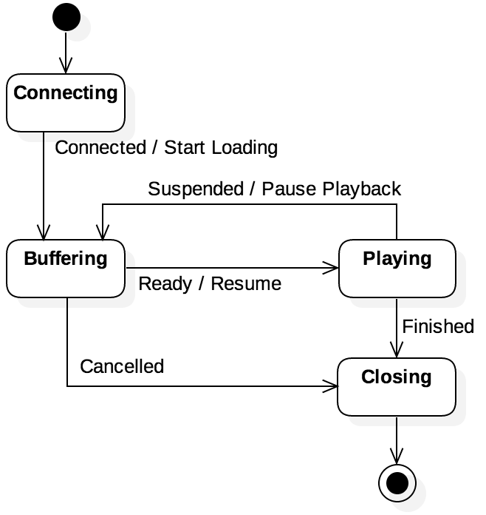
UML state models
As discussed in COMP 3100, UML standardizes state models as a way to visualize states and transitions
  States are shown as rounded rectangles
  A solid circle shows the initial state
  A solid circle in a circle shows the final state
  Transitions are shown as labeled arrows
  Effects (if any) are written after a slash after the transition label

Slide 18
State space explosion
When constructing state machines from some other representation, it's possible to generate a large number of states
For example, a different state for every configuration of bits in a 32-bit integer would mean 2³² ≈ 4 billion different states
To be useful as models, there needs to be a reasonable number of states
  Different states can be grouped together based on what's meaningful for a given problem

Slide 19
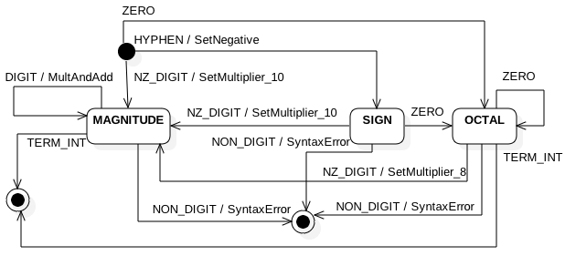
State machines as recognizers
State machines are often used to recognize strings as being legal or illegal
Consider a state machine from Project 1 designed to recognize integer values (formatted in either decimal or octal)
In addition to recognizing integers as legal or illegal, the machine builds the integer based on the effects

Slide 20
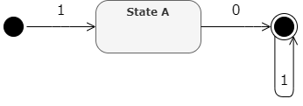
Regular expressions and state machines
As COMP 3200 covers, regular expressions and finite state machines are equivalent
  For every regular expression, there's an equivalent FSM
  For every FSM, there's an equivalent regular expression
Example:
  Regular expression: 1 0 1*
  FSM:

Slide 21
Implementing state machines
There are algorithms to convert between regular expressions and state machines
Most regular expression libraries build a state machine as a way to see if strings match the regular expression
One way to implement state machines is with a 2D array
  One row for every state
  One column for every event, saying which state a given state will transition to
If there are effects, a second 2D array can show which effects happen on those transitions
If an action happens whenever a state is entered, a 1D array can hold that information

Slide 22
Example transition table
The state model on the left has a transition table on the right
 | Events
States | Connect | Suspend | Ready | Finish | Cancel
Connecting | Buffering
Buffering |  |  | Playing |  | Closing
Playing |  | Buffering |  | Closing
Closing

Slide 23
Example table in code
Two enums are used to list the states and the events
A 2D array stores the transitions
typedef enum { CONN, BUFF, PLAY, CLOS, NST } ms_t;
typedef enum { Connect, Suspend, Ready, Finish, Cancel } event_t;
#define NUM_STATES (NST+1)
#define NUM_EVENTS (Cancel+1)
static ms_t const _transition[NUM_STATES][NUM_EVENTS] =
{
// Connect Suspend Ready Finish Cancel
{ BUFF, NST, NST, NST, NST }, // Connecting
{ NST, NST, PLAY, NST, CLOS }, // Buffering
{ NST, BUFF, NST, CLOS, NST }, // Playing
{ NST, NST, NST, NST, NST } // Closing
};

Slide 24
Effects
A table filled with function pointers can be used for effects
static action_t const _effect[NUM_STATES][NUM_EVENTS] = {
// Connect Suspend Ready Finish Cancel
{ start_load, NULL, NULL, NULL, NULL }, // Connecting
{ NULL, NULL, resume, NULL, NULL }, // Buffering
{ NULL, pause_play, NULL, NULL, NULL }, // Playing
{ NULL, NULL, NULL, NULL, NULL } // Closing
};

Slide 25
Sequence Models

Slide 26
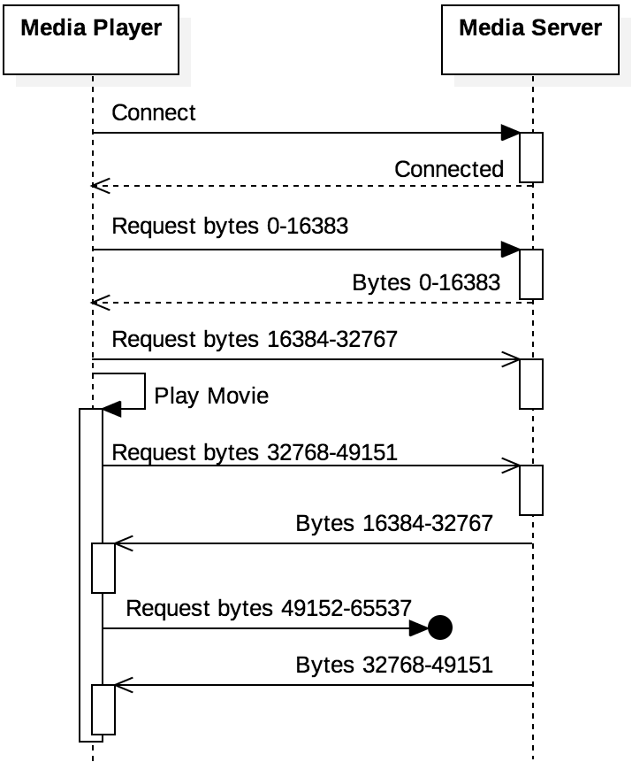
Sequence models
State models don't have any timing or sequence information
Sequence models show the order in which messages are sent from one entity to another
  Solid arrows show synchronous messages
  Open arrows show asynchronous messages
  Dotted lines show responses
  Messages that end in circles are lost
The order of messages in sequence models is logical, not scaled by time

Slide 27
Upcoming

Slide 28
Next time…
Processes
Multiprogramming
Kernel

Slide 29
Reminders
No class on Monday
Work on Assignment 1
  Due next Friday by midnight!
Look over Project 1
Read sections 2.1, 2.2, and 2.3

